Slide 1
Planning progressive lessons in primary p.e.
Early
First
Second
Third

Slide 2
Course Aims
Reinforce the importance of P.E. as an educational entity delivered by GTCS registered teachers
Emphasise that class teachers are the experts of their own classes and don’t have to be ‘sporty’ to deliver P.E.
Provide a simple formats and approaches that can be used to ensure that P.E. at lessons through primary are age and stage appropriate
Show examples of the impact of progressions from P1-P7
Give teachers the confidence to deliver P.E. at all stages

Slide 3
Curriculum For Excellence (CFE), est 2007
3-18 Broad General Education (BGE) Curriculum
PE part of Health & Wellbeing: Experiences and Outcomes
Nursery/P1 to S3, Levels Early, First, Second, Third, Fourth

Slide 4
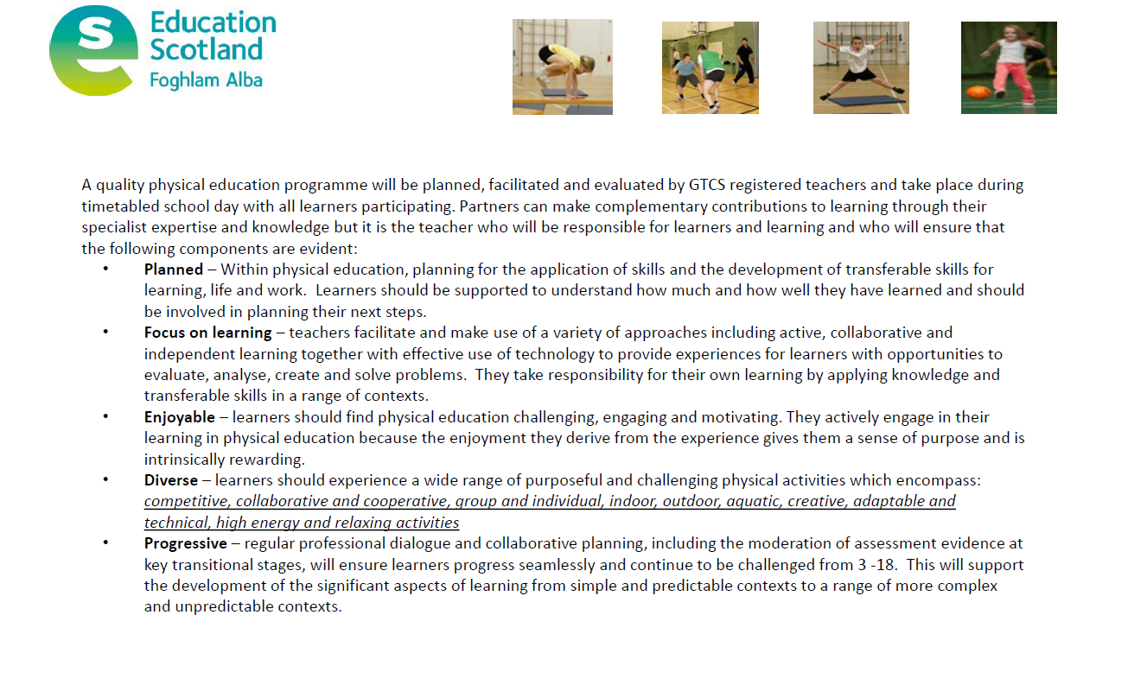
Curriculum For Excellence (CFE), est 2007
3-18 Broad General Education (BGE) Curriculum
PE part of Health & Wellbeing: Experiences and Outcomes
Nursery/P1 to S3, Levels Early, First, Second, Third, Fourth

Slide 7
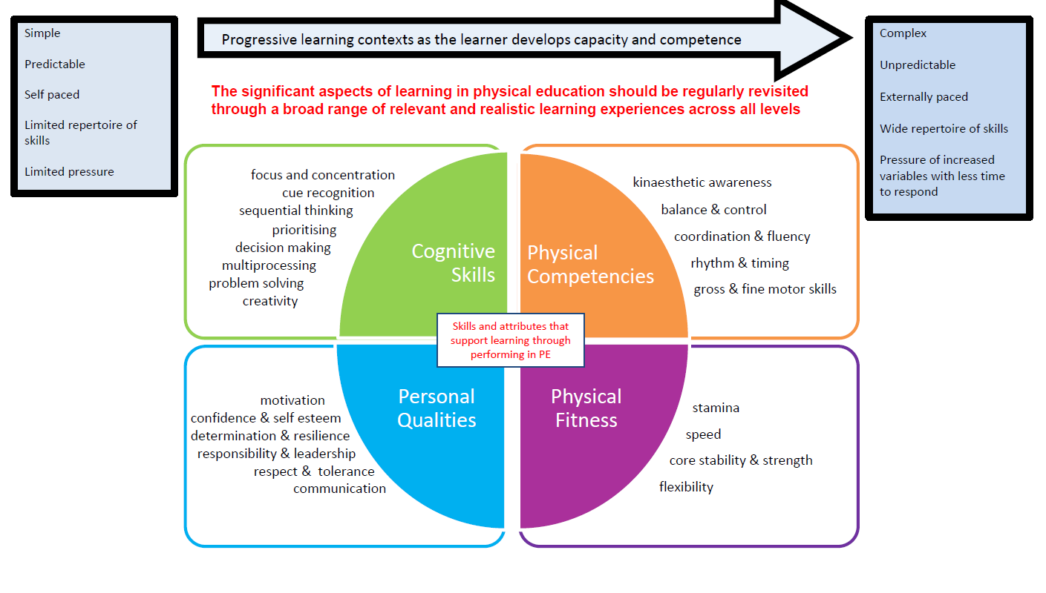
PE Benchmarks, est 2017 (formerly Significant aspects of learning, 2014)

Slide 8
The role of primary P.E.
Provide a foundation of Fundamental Movement skills (Physical)
Provide opportunities to develop core skills and knowledge in a different, physical domain. Also contributes to mental wellbeing e.g. endorphins (Mental)
Provide opportunities to develop social skills, e.g. teamwork and communication (Social)
Provide opportunities to test and develop emotional regulation and coping strategies (Emotional)
Foster positive attitudes towards PE, Physical Activity and Sport (PEPAS)
Help to raise attainment in secondary school – improved base level of skills & knowledge will raise the standards/expectations in PE, more focus on higher order thinking skills in S1-3 and better equip pupils to do well in National 5 and Higher

Slide 9
IMPACT
Identification of physical development needs, especially at early level
Pupil participation in more games and activities with others during break times
Increased pupil attendance at extra-curricular sports clubs
More active pupils can have a positive effect in the classroom
Pupils go on to succeed in sports outwith school
Pupils better prepared for transition into secondary: (positive attitude to P.E.; increased competence, confidence and enjoyment of P.E. lessons; more opportunities to attend and make friends at extra curricular clubs)
Raising Attainment: pupils with a better grounding of P.E. in Primary will positively impact their ability to do well in National and Higher P.E.

Slide 10
the way forward
A clear definition of PE maintaining emphasis on both the Physical and Educational aspects. Quality PE is not just activity
Focus on developing pupils’ Physical Literacy, Fundamental Movement Skills (FMS) and knowledge to enable & encourage regular participation in sport and/or physical activity
Clear, simple framework/overview (skeleton)
Teachers Supported by EIS and other agencies for advice and content ideas
Teachers empowered to deliver lessons with autonomy, creativity and confidence

Slide 11
Working timetable example Working Area: gym hall/Outdoors/classroom
DAY | 9.30-10.30 |  | 10.45-11.45 | 1.00-2.00 |  | 2.00-3.00 2.00-2.30 2.30-3
MONDAY | P5 (9.40-10.20)* | P5 | P6 | P3 1.10-1.50 |  | P1 1.50-2.20 | P2 (2.20-2.50)
TUESDAY | P5 (9.40-10.20) | P5 | P6 | P3 1.10-1.50 |  | P1 1.50-2.20 | P2 (2.20-2.50)
WEDNESDAY | P3 (9.30-10) |  | P7 | P4 1.10-1.50 |  | P1 1.50-2.20 | P2 (2.20-2.50)
THURSDAY | P3 (9.30-10) |  | P4 (11-11.40) | P5 (1.10-2.50)* |  | P1 | P2
FRIDAY | P4 (9.40-10.20) |  | P7

Slide 12
Calendar overview (suggested)
Stage | Aug | Sep | ESSD Sports Week | Maths Week Scotland | Oct | Nov | Dec | Jan | Feb | Mar | Apr | May | Jun
Early (P1-3) | Travel/ locomotor BMT Throw and Catch | Gymnastics/movement games | Assigned Sport choice (adapted for younger classes) | Numeracy Related Activities or Current activity with numeracy focus Eg gymnastics problem solving, create a ‘sum sequence’ | Striking/target – Halloween theme | Strike, Catch, Strike (Bat and ball/object) | Christmas theme Snowball dodgeball Christmas target games Building snowmen Curling/ winter sports | Dance/ movement to music Parachute games | Kick, Stop, Roll | Balloons | Pedal, Glide, Wheel | Run, throw, jump | Summer games Striking Outdoor play (including bubbles)
First (P3-5) | Small ball skills/ Handling BMT | Large Ball skills/ Handling (inc bounce, catch, throw) |  |  |  | Yoga Combat/ martial arts |  | Social Dance Jump rope Rhythm activities | Football (Kicking & dribbling skills) | Gymnastics | Volleyball Bikeability | Athletics (Through games)
Second (P6-7) | Rugby/ NFL | Basketball/ Netball |  |  | Hockey | Badminton | Dodgeball Boccia Table games | Social Dance Jump rope Rhythm activities | Football | Gymnastics | Volleyball Bikeability | Athletics | Softball, cricket, rounders,
P1 & 2: focus on FMS and Play. Sugg

Slide 13
Physical Literacy
“Physical literacy is the motivation, confidence, physical competence, knowledge and understanding to value and take responsibility for engagement in physical activities for life.”
The International Physical Literacy Association May 2014
www.physicalliteracy.ca

Slide 14
Fundamental MOVEMENT SKILLS (FMS)
“Fundamental Movement skills are movement patterns that involve various body parts and provide the basis for Physical Literacy.”
Lindsay Broomfield, Complete Guide to Primary Gymnastics (2011)
Locomotor (Body Movement) | Stability (Body Management) | Manipulative (Object Control)
Run Jump (height) Jump (distance Skip Hop Gallop Crawl Swim | Roll Land Bend Stretch Turn Swing Climb | Throw Catch Bounce Strike (eg hockey stick, bat, racket) Balance (on head, body, bat, racket) Kick Dribble

Slide 15
Progressing PE through primary
 | P1 & 2 | P3, 4 & 5 | P6 & P7 | P7
Focus & Approaches (suggested) | FMS, Play, social games (eg parachute), Story approach, BMT, movement to music, gymnastics Outdoor learning opportunities | TGFU, cooperative/team games, BMT, introduction to benchmarks Aesthetics (Dance, gymnastics) Outdoor learning opportunities | Sport Education Sport specific skills, Cooperative learning Development of benchmark knowledge Outdoor learning opportunities | Sport specific, transition to Secondary, BGE Journal/Diary
Frequency& Duration (suggested minimum) | 4 x 30 mins per week (2 hours) | 3 x 40 mins per week (2 hours) | 2 x 1 hour per week (2 hours) | 2 x 1 hour per week (2 hours)
Outcomes/ Benchmarks | Introduce concepts, develop knowledge of basic movements and words | Introduction to benchmarks in LI and plenary | Benchmark discussion in LI/SC and/or plenary Pupils self assess on benchmarks in BGE Journal/Diary
Delivered by | Class teacher led (with appropriate Support) | Class Teacher led (with appropriate Support) | Class Teacher Visiting Secondary PE teacher (where available for transition)
P1 & 2: focus on FMS and Play. Sugg

Slide 16
SUGGESTED LESSON FORMAT
 | P1 & 2 | P3, 4 & 5 | P6 & P7 | P7
Frequency& Duration (suggested minimum) | 4 x 30 mins per week (2 hours) | 3 x 40 mins per week (2 hours) | 2 x 1 hour per week (2 hours) | 2 x 1 hour per week (2 hours)
Suggested Lesson Breakdown | 5 mins: pulse raiser warm up 10 mins: FMS Focus 10 mins: Game/Free play 5 mins: Relaxation (Give out PE stars) | 5 mins: Pulse raiser warm up 10 mins: Skill introduction 20 mins: TGFU Game 5 mins: Cool down/ Relaxation/Plenary (Give out PE stars)
P1 & 2: focus on FMS and Play. Sugg
10 mins: pulse raiser warm up including skill development
10 mins skill development
15 mins: TGFU related to theme
20 mins: Game
5 mins Cool Down/Plenary
(Give out PE stars)

Slide 17
Weekly planner (SUGGESTED FORMAT)
DAY | P1-3 | P3-5 | P6&7
1 | Introduce Fundamental Skill focus (Allow pupils to explore the skill) | Introduce the skill/Game focus TGFU approach | Skills focus Game/sport related practice
2 | Consolidate/Develop Fundamental Skill focus (build on prior knowledge) | Consolidation of previous lesson. Reinforce and/or develop the concepts covered | Reinforce previous day’s focus Emphasis on small sided games
3 | Social Development: Cooperate/compete with others | Development of game concepts Relate to SALs
4 | Free play/Game day
Don’t be afraid to repeat the same lesson if you think the points need more time to develop or be reinforced. Teacher judgement is key.

Slide 18
LESSON PLANNING: P1-3 (Play focus)
Week/Day | Warm up | Skills focus (eg Throwing) | Game/Application | Cool Down/Relaxation | Equipment needed
1 | Teacher directed warm up, BMT, include jogging, skipping, sidestepping running backwards etc | Throwing and Catching (small ball) Individual work, Eg Hand to hand, Two hands to one hand Encourage creativity (eg pick best 3) | Knock the hat off the snowman/person All pupils are snowmen with a marker on their head for a hat. Knock as many hats off without losing yours. Set number of lives | Musical Catching Throw and catch the ball to yourself. When the music stops, you must have the ball in your hands. 3 lives then put your ball away and sit down and be an extra judge. | Small ball | 1 each
 |  |  |  |  | Pointy Cones | 1 between 2
 |  |  |  |  | Marker cones | 1 between 2
 |  |  |  |  | Pool noodles | 3-5
2 | Frozen tig 3 Ice Wizards with a freeze wand (pool noodle) If you are tagged, the only way you are unfrozen is if you catch a magic snowball from a partner | Save the Forest (Put out the forest fires using your snowball) Trees on fire = cones with beanbags on top Throw snowball and knock beanbag off the cone | Ice cream cones (pupils have a cone or marker (oyster) each and have to throw and catch a snowball: with a partner As many partners as you can | Rainbow Breaths (Go Noodle) | Small ball | 1 each
 |  |  |  |  | Pointy Cones | 1 between 2
 |  |  |  |  | Marker cones | 1 between 2
 |  |  |  |  | Pool noodles | 3-5
3 | Movement to music: when the music plays run/skip/move as directed. When it stops, freeze/crouch/stand in a certain way | Individual work: cone and ball, throw and catch to self or with a partner. Can you flip the ball out and catch it? | Clear your garden 2 teams in a half of the hall each Throw the snowballs into your neighbours garden to make sure yours is clear! | Victorious (Go Noodle) | Small ball | 1 each
 |  |  |  |  | Pointy Cones | 1 between 2
 |  |  |  |  | Marker cones | 1 between 2
 |  |  |  |  | Pool noodles | 3-5
4 | Pupils choose a warm up game e.g. any tig game | Free play Either set out lots of equipment and pupils choose or Set up focused play zones Pupils responsible for tidying equipment. |  | Musical Statues | Frisbees | Bikes
 |  |  |  |  | Large ball set | Small ball set
 |  |  |  |  | Hoops | Beanbags
 |  |  |  |  | Scarves | Tennis bats

Slide 19
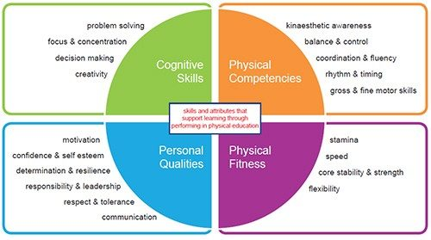
Lesson planning: p1-3 Example
THROWING
Accuracy
Technique
Towards a target
Hit a target
To a partner
Right/Left/Two hand
Underarm/Overarm
Side on position
Transfer Weight
Follow through
Pupils will develop their throwing skills and demonstrate application and understanding in a range of contexts
Benchmarks Covered
 | I can
 | Work independently to throw and catch the ball
 | Throw the ball in different ways (e.g. left/right/two hands)
 | Throw the ball towards/accurately towards a target
 | Throw and catch the ball with a partner
 | Throw/catch in dynamic/pressured situations

Slide 20
Quality p.e.: questions for reflection
 | Have the pupils had opportunities to:
Physical | Take part in Heart/pulse raising activities? Develop/Explore Fundamental skill and movement? Apply their skills and knowledge in dynamic/challenging contexts?
Mental | Problem solve and make decisions? Develop confidence and individual responsibility? Explore and be creative?
Social | Cooperate/share space with others? Compete against or alongside others? Communicate with others? Play?
Emotional | Regulate their emotions within a busy/dynamic/competitive environment? Play independently and/or with others? Have fun and enjoy themselves?

Slide 21
Primary PE
Fundamental Movement Skills
Cooperation
Social Development
Physical Health
Competition
Play
Emotional Development
Fun!
Mental Health

Slide 22
STEP APPROACH |  | EXAMPLES | SUGGESTIONS
S | PACE | Ensure that you are aware of and consider the health and safety requirements of the area you are working in. E.g. tables and chairs, trip/slip hazards- etc | If the hall doubles up as a canteen make sure any spillages and food are cleared up. Make sure any chairs are pushed to the side to maximise the space and minimise hazards
 |  | If the space e.g. gym hall is unavailable, e.g. for an assembly or other activity, have a contingency plan in place to make sure some form of PE can take place, eg YouTube, class based fitness or skills activities, adapted yoga or dance etc | Go Noodle, Better Movers and Thinkers class activities, Adapted Yoga/Tai Chi Target/Table games, YouTube simulator games e.g. Coach Corey Martin, Cosmic Yoga Just Dance
T | ASK | Have an overview of the set tasks for each week with focused learning intentions. Use your pupils interests to help select activities that will help to engage them and add to the learning experiences | Have a clear PE timetable and calendar so you can see which activities are being covered across the year and also to ensure a breadth of experiences. eg Star Wars, Frozen, Mario, Marvel, Transport, Animals etc
 |  | Ensure that pupils experience a broad range of skills and contexts covering a number of areas | Aesthetic, team, Individual, net & rebound, invasion games etc
E | QUIPMENT | Ensure that equipment is organised and tidied regularly in allocated spaces. This can be overseen by a member of staff or P7 pupils. Regular check/refresh of equipment where required | P7 Sports leaders in charge of tidying PE cupboards Equipment divided according to type e.g. balls, shuttles, throwing equipment or stage eg early years equipment, P7 equipment etc
 |  | And be creative with the equipment you use. It doesn’t always have to be ‘traditional’ PE equipment | Paper aeroplanes or scrunched balls of paper for throwing activities Use of balloons for striking and throwing/catching Use of bubbles for outdoor activities ‘Junkyard’ Olympics?
P | EOPLE | Be aware of how many are in the class and how to organise them into pairs groups. Especially for team and group games. Circle, pairs across from each other | Pupils in pairs across from each other? Or in small group circles Team games: if playing more traditional activities, what is the maximum number we can have on at any one time? E.g. 5v5 with regular rotations and observation tasks given to those sitting off.
 |  | Use the knowledge of your class and judgement to establish clear routines E.g. how do we start the lesson? | Pupils can all be sat on the bench before being given instructions (classes that need to be settled before they start) Pupils can be allowed to run to burn of energy for a couple of minutes (this may help to calm them down for instructions to be given when sat back down) Pupils can be provided with a set warm up that they have to do upon entering the hall (encourages responsibility)

Slide 23
Key considerations
Have a clear skills focus, but the context in which this is delivered is up to you
Use your own interests and the interests of your pupils as the context for learning
Don’t be afraid to stand back and observe. Watch the class, give pupils time to explore and to problem solve. And then step in where necessary
Let the pupils guide the learning. Highlight good practice or creativity and let them demonstrate to the class
Plenary: ask pupils to identify Significant Aspects of Learning from the lesson and explain why
Don’t be afraid to repeat a lesson more than once. Use your judgement. If you think pupils need more time, trust your instincts
Have fun

Slide 24
Takeaways
Physical Literacy
Primary P.E. has a massive role to play in the development and learning of our pupils, not just for school, but for life. Leave nothing to chance
Keep the Physical in Physical Education
The physical domain is what makes P.E. unique and special. Keep our pupils purposefully active
Keep the Education in Physical Education
P.E. is an educational entity and should be led and delivered by GTCS Registered Teachers (coaches etc can support, but teachers should plan and lead lessons according to Es & Os and Benchmarks)
Enjoy yourself!
Primary teachers are the most creative teachers there are!! Use your own interests to make it fun for all
Believe!
You are the specialist! You know your own pupils better than anyone

